Slide 1


Women's E-Commerce Clothing Reviews
NLP
&
Unsupervised Learning
Yazeed Alharthi | Abdullatif Alsabr
Aljoharah Alaqeel | Rahaf Alturbaq

Slide 2
Introducion
This is a Women’s Clothing E-Commerce dataset revolving around the reviews written by customers. Also evaluate customer satisfaction with products processed by the previous piece

Slide 3
Outline
01
02
03
04
Introduction
About Dataset
Challenges
05
06
Models
Tools
Conclusion

Slide 4
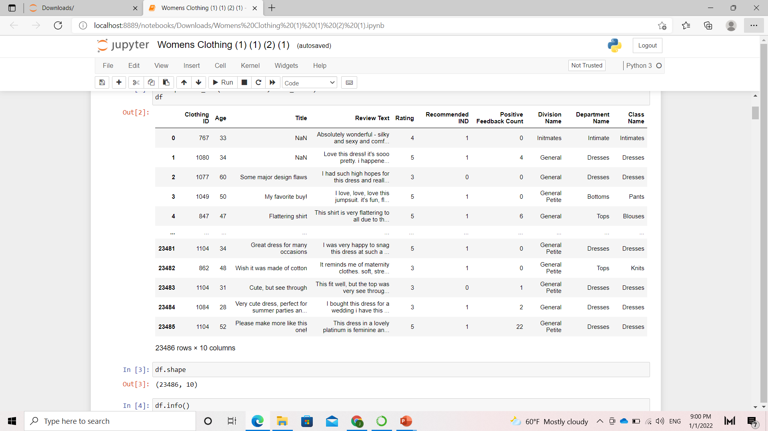
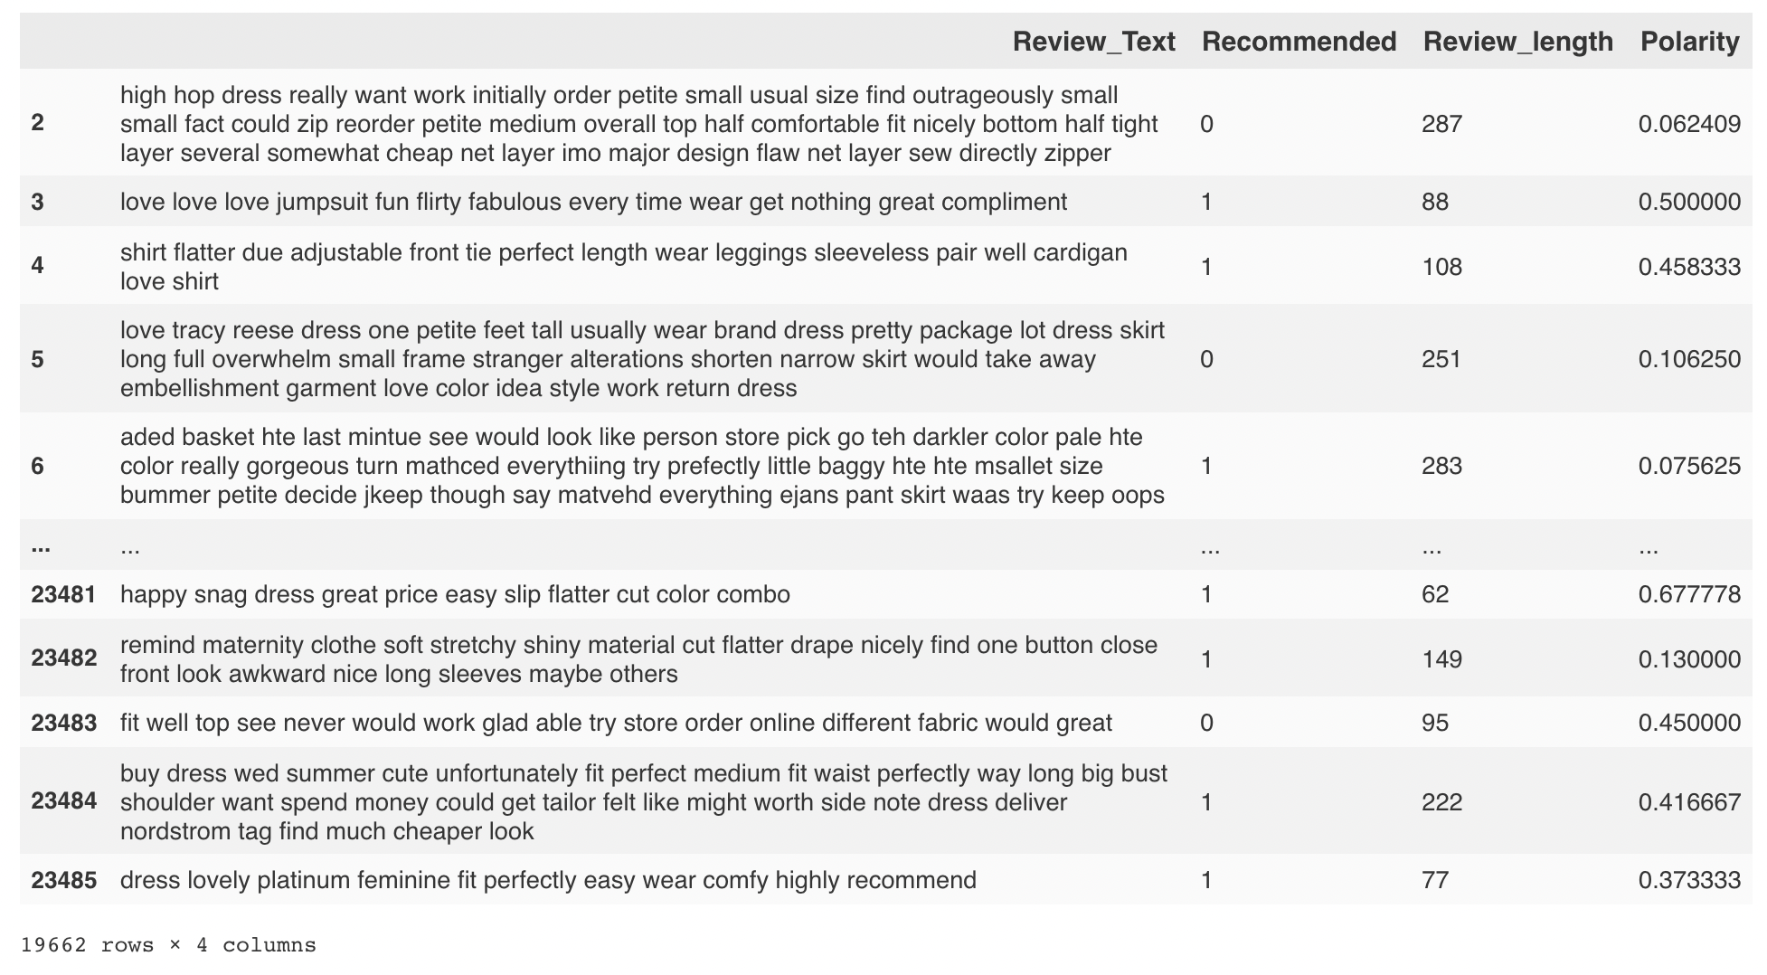
About Dataset
Before cleaning:
Our Dataset contained 10 columns, and 23486 rows
After cleaning:
Our Dataset contained 4 columns, and 19662 rows
Recores: Kaggle

Slide 5
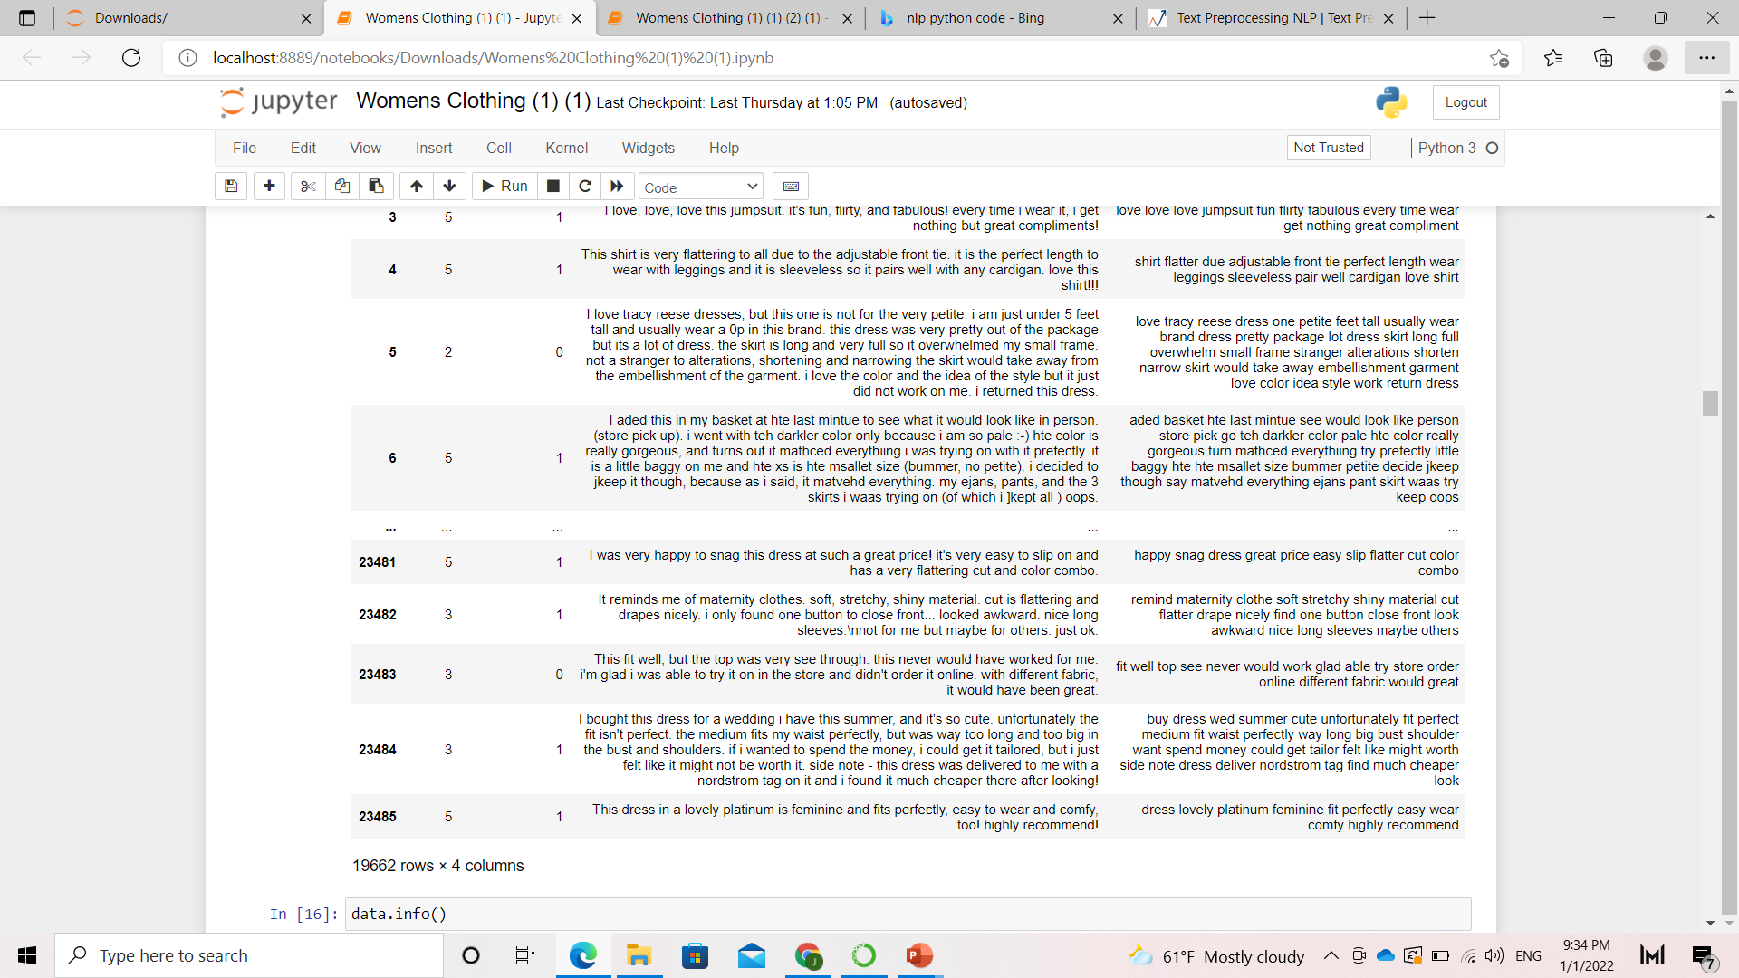
Challenges
Duplicated and unnecessary data
Text preprocessing
Build model
Review Text
Review Text Clean

Slide 6
Topic Modeling
Latent Semantic Analysis(LSA)
Latent Dirichlet Allocation(LDA)
Non-Negative Matrix Factorization(NMF)

Slide 7
Latent Semantic Analysis(LSA)
Topic 1: dress love fit size wear look like great color fabric
Topic 2: dress beautiful love wear perfect great flatter casual fabric make Topic 3: size fit order small run store petite true medium retailer
Topic 4: look like make fabric cute picture shape really model good
Topic 5: fit great like color perfect flatter nice soft perfectly cute
Topic 6: wear great cute comfortable sweater buy fit shirt jeans flatter
Topic 7: great look soft size pant love color jeans buy fit
Topic 8: color fabric beautiful soft nice great buy flatter shirt really
Topic 9: small run cute large medium order shirt little wear big
Topic 10: like cute really feel great love fabric super material felt

Slide 8
Latent Dirichlet Allocation(LDA)
Topic 1: size arm sweater fit try sleeves order shirt like petite
Topic 2: size small dress run order large fit wear beautiful medium
Topic 3: shrink wash instructions dry care say size cold purchase clean
Topic 4: quality material love bra really buy use return poor tag
Topic 5: easy sweater pretty dress love fun wear comfortable comfy look
Topic 6: bib creatively happy design print petite bodice tie knot safety
Topic 7: tunic fit love price wrinkle barely cover expect easily picture
Topic 8: belt picture come flute flowy flouncy flour flow flower flowery
Topic 9: dress love fit size wear look great like color fabric
Topic 10: wear chest travel pregnant think pant kind years shoulder structure

Slide 9
Non-Negative Matrix Factorization(NMF)
Topic 1: dress love fit size wear look like great color fabric
Topic 2: dress beautiful love wear perfect great flatter casual fabric make
Topic 3: size fit order small run store petite true medium retailer
Topic 4: look like make fabric cute shape picture really good think
Topic 5: fit great like color perfect flatter nice soft cute perfectly
Topic 6: wear great cute comfortable sweater buy fit shirt jeans perfect
Topic 7: great look size soft pant love color jeans buy fit
Topic 8: color fabric beautiful soft great nice buy flatter shirt pretty
Topic 9: small run large cute medium shirt order little big wear
Topic 10: like cute really feel shirt great fabric super love make

Slide 10
Workflow of models
Recommender
System
TF-IDF
PCA
Build

Slide 11
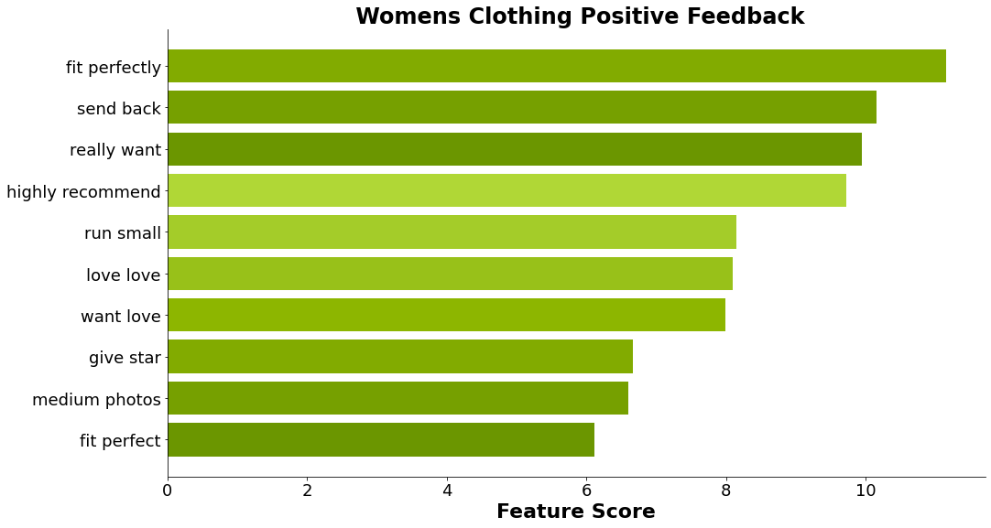
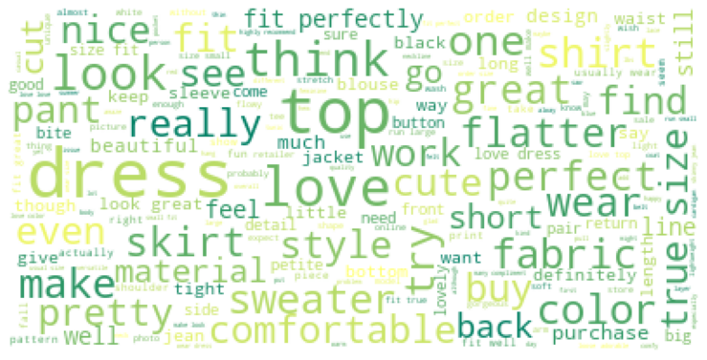
The Most frequent positive words

Slide 12
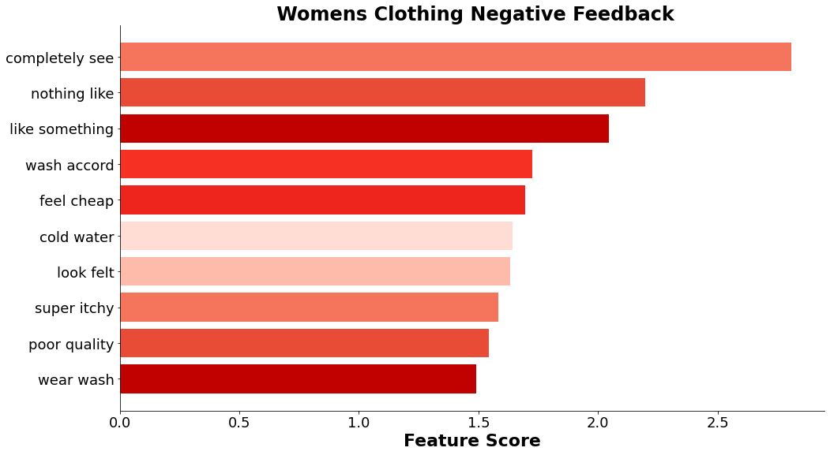
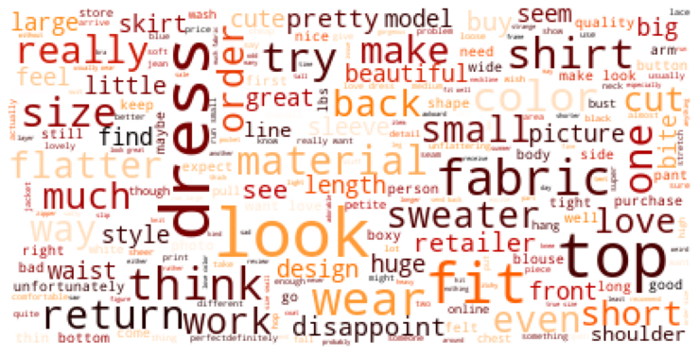
The most frequent negative words

Slide 13
Supervised Models
Model | Accuracy | Accuracy
 | Before | After
Support Vector Machine | 0.66 | 0.70
Random Forest | 0.65 | 0.75
Logistic Regression | 0.69 | 0.69

Slide 14




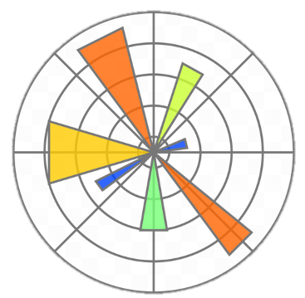



Tools
NumPy
Seaborn
Scikit learn
Gensim
Jupyter
Notebook
Plotly
Pandas
Matplotlib

Slide 15
Conclusion
Through the system, we were able to distinguish between negative comments and positive comments, and this leads us to focus on negative comments and raise the efficiency of these products, and thus we can increase customer satisfaction and also raise the percentage of sales

Slide 16
Thank you for your attention! Any Question?

